Slide 1
Building Cloud Native applications with .NET Core
Johnny Hooyberghs

Slide 2
Cloud Native
The Cloud Native Computing Foundation

Slide 3
Cloud Native Technologies
Cloud native technologies empower organizations to build and run scalable applications in modern, dynamic environments such as public, private, and hybrid clouds. Containers, service meshes, microservices, immutable infrastructure, and declarative APIs exemplify this approach.
These techniques enable loosely coupled systems that are resilient, manageable, and observable. Combined with robust automation, they allow engineers to make high-impact changes frequently and predictably with minimal toil.
The Cloud Native Computing Foundation seeks to drive adoption of this paradigm by fostering and sustaining an ecosystem of open source, vendor-neutral projects. We democratize state-of-the-art patterns to make these innovations accessible for everyone.

Slide 4


Slide 5
Cloud Native Technologies
Cloud native is microservices hosted in containers and serverless apps, that can run in multi-cloud environments and are managed by DevOps processes

Slide 6
Cloud Native Technologies
Cloud native is microservices hosted in containers and serverless apps, that can run in multi-cloud environments and are managed by DevOps processes

Slide 7
Microservices
A collection of loosely coupled services, where services are fine-grained and protocols are lightweight

Slide 8
Containers
A standardized unit for storing, shipping and deploying a software package to run quickly and reliably, independently of computing environment

Slide 9
Serverless
Thanks to cloud computing: scaling, capacity planning and maintenance can be hidden from the developer or operator
Focus on your application, not the infrastructure

Slide 10
Multi-cloud
The use of multiple cloud computing and storage services in a single network architecture and the ability to be cloud-agnostic

Slide 11
DevOps
A set of practices that combines software development and IT-operations, to shorten system development lifecycle and provides continues delivery

Slide 12

CSharpWars
Why use a simplified sample app when you can use a real app ☺

Slide 13


Slide 14
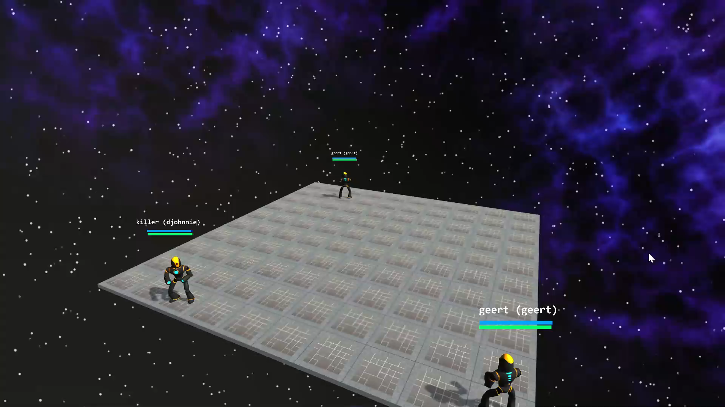

Slide 15
CSharpWars Robot Scripting
var step = LoadFromMemory<Int32>("STEP");
if( step % 3 == 0 )
{
TurnLeft();
}
else
{
WalkForward();
}
step++;
StoreInMemory<Int32>("STEP", step);

Slide 16

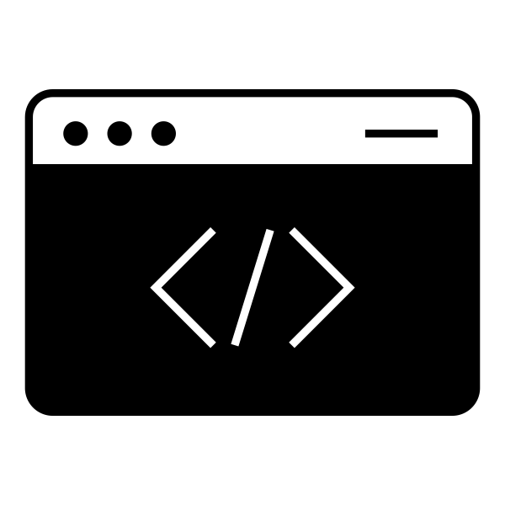
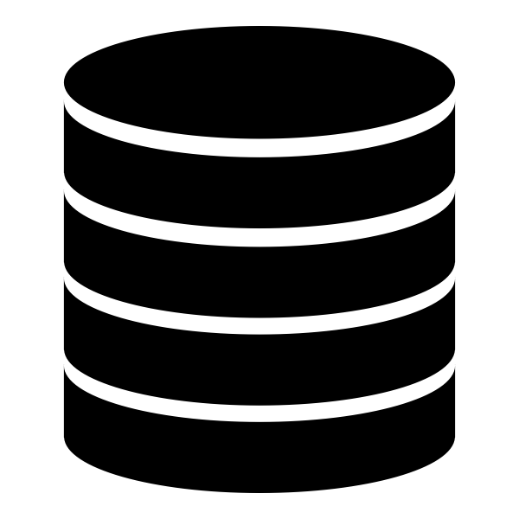



HTTP API
Frontend
Database
Processor
WebApp
Validator

Slide 17
HTTP API
Frontend
Database
Processor
WebApp
Validator

Slide 18
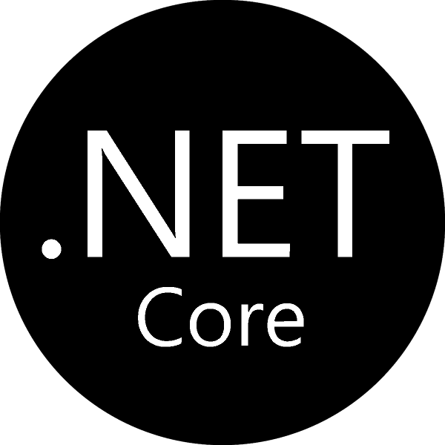
.NET Core
What can .NET Core do to help with cloud native

Slide 19
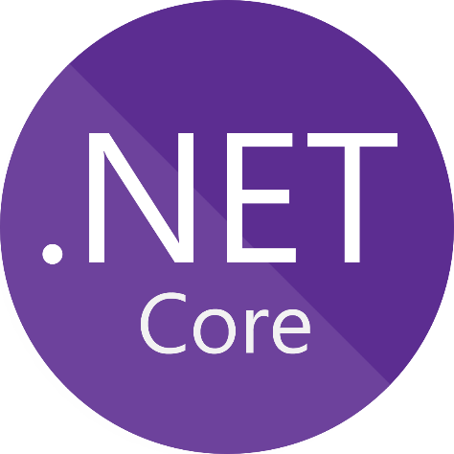
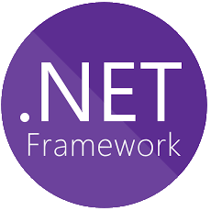
.NET Core vs. .NET Framework
Platform independent
High performance
Lightweight
Future-proof
Cloud Native compatible
The way to go for new apps
Backwards compatible
Restricted to Windows
Better Windows-integration (*)
Cloud Native compatible
The way to go for legacy apps
(*) .NET Core will close this gap in the coming years from .NET 5 onwards

Slide 20







.NET Core is Platform Independent
Windows
Linux
Mac
x86, x64, arm32, arm64
Cloud
IoT
Docker

Slide 21
.NET Core SDK is not bound by tools
Welcome to .NET Core SDK CLI…
> dotnet new
> dotnet restore
> dotnet build
> dotnet publish
> dotnet test
> dotnet run

Slide 22
Dependency Injection
[Route("[controller]")]
[ApiController]
public class ArenaController : ApiController<IArenaLogic>
{
public ArenaController(IArenaLogic arenaLogic) : base(arenaLogic) { }
// GET api/values
[HttpGet]
public Task<IActionResult> GetArena()
{
return Success(l => l.GetArena());
}
}

Slide 23
Configuration
public class ArenaLogic : IArenaLogic
{
private readonly IConfiguration _configuration;
public ArenaLogic(IConfiguration configuration) {
_configuration = configuration;
}
public Task<ArenaDto> GetArena() {
return Task.FromResult(new ArenaDto {
Width = _configuration.GetValue<int>(“ARENA_SIZE”),
Height = _configuration.GetValue<int>(“ARENA_SIZE”)
});
}
}

Slide 24
Logging
try {
using var sw = new SimpleStopwatch();
var middleware = scopedServiceProvider.GetService<IMiddleware>();
await middleware.Process();
_logger.LogInformation(
"[ CSharpWars Script Processor - PROCESSING {ElapsedMilliseconds}ms! ]“
, sw.ElapsedMilliseconds);
} catch (Exception ex) {
_logger.LogError(ex,
$"[ CSharpWars Script Processor - EXCEPTION - '{ex.Message}'! ]");
}

Slide 25

Microservices
A collection of loosely coupled services, where services are fine-grained and protocols are lightweight

Slide 26
What are Microservices?
Architectural style
Divide monolithical application into smaller applications
Add a communication layer between these smaller applications

Slide 27
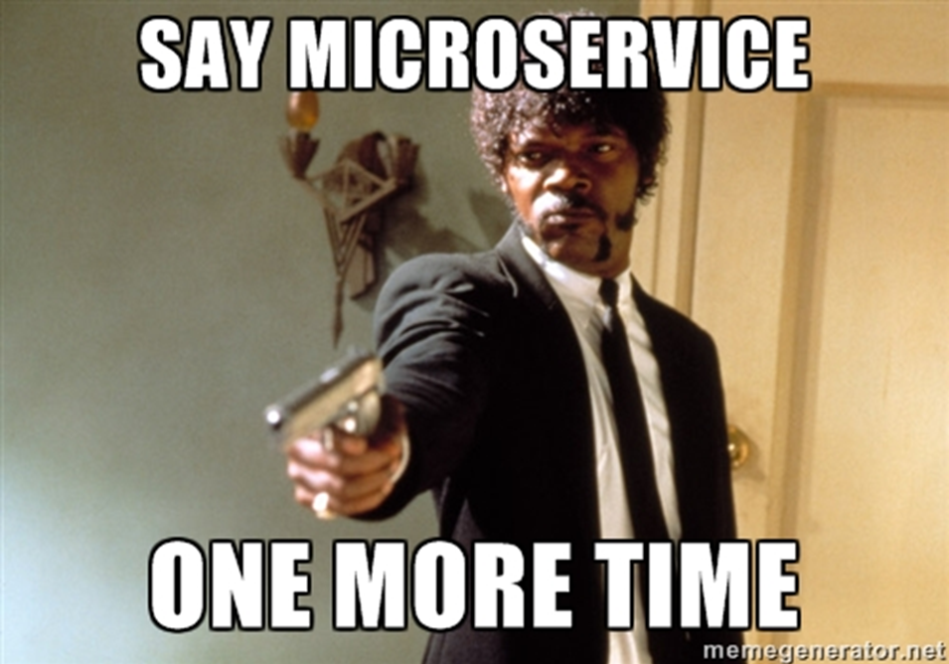

Slide 28
Why Microservices
Increased performance
Easier to pinpoint a performance bottleneck in the system
Easier to scale out
Increased manageability
Easier to upgrade part of the system in isolation
Easier to do feature-updates
Increased velocity
Easier to scale out teams
Increased flexibility
Easier to use different technologies
Easier to use different programming languages

Slide 29
Should you use Microservices?
Large applications
That (can) have clear defined boundaries
That should be scalable
Large teams
Than can work on different parts of the application in parallel
To increase flexibility and velocity
YES

Slide 30
Should you use Microservices?
Small or lightweight applications
Distributed applications are hard
More chances of failing parts
Harder to work together as a team
More communication needed between different teams
Difficult to define boundaries
NO

Slide 31
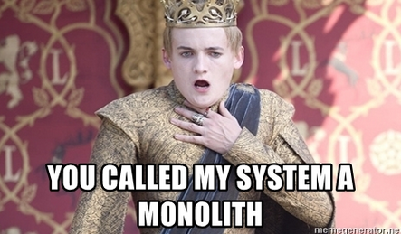

Slide 32
.NET Core to develop Microservices
ASP.NET Core WebApi for HTTP & JSON based communication
ASP.NET Core gRPC for HTTP/2 & Binary based communication
.NET Core Worker Services for background processing
External messaging and pub/sub infrastructure & frameworks
Azure Service Bus
NServiceBus
Dapr
…

Slide 33
.NET Core to host Microservices
ASP.NET Core has a built-in webserver called Kestrel
Runs on Windows, Linux and Mac
Runs on Raspberry Pi
Runs on a potato
Host in IIS
Host in Azure App Service
Host inside Docker container
…

Slide 34
ASP.NET Core WebApi (server)
[Route("[controller]")]
[ApiController]
public class ArenaController : ApiController<IArenaLogic>
{
public ArenaController(IArenaLogic arenaLogic) : base(arenaLogic) { }
// GET api/values
[HttpGet]
public Task<IActionResult> GetArena()
{
return Success(l => l.GetArena());
}
}

Slide 35
ASP.NET Core WebApi (client)
public static Arena GetArena()
{
return Get<Arena>("arena");
}
private static TResult Get<TResult>(string resource) where Tresul
: new()
{
var client = new RestClient(_baseUrl);
var request = new RestRequest(resource, Method.GET);
var response = client.Execute<TResult>(request);
return response.Data;
}

Slide 36
ASP.NET Core gRPC (contract)
syntax = "proto3";
option csharp_namespace = "CSharpWars.Validator";
package Validator;
service ScriptValidator {
rpc Validate (ScriptValidationRequest) returns (ScriptValidationResponse);
}
message ScriptValidationRequest {
string Script = 1;
}
message ScriptValidationResponse {
int64 CompilationTimeInMilliseconds = 1;
int64 RunTimeInMilliseconds = 2;
repeated ScriptValidationMessage ValidationMessages = 3;
}
message ScriptValidationMessage
{
int32 LocationStart = 1;
int32 LocationEnd = 2;
string Message = 3;
}

Slide 37
ASP.NET Core gRPC (server)
public class ScriptValidatorService
: ScriptValidator.ScriptValidatorBase {
private readonly IScriptValidationHelper _helper;
public ScriptValidatorService(IScriptValidationHelper helper) {
_helper = helper;
}
public override Task<ScriptValidationResponse> Validate(
ScriptValidationRequest request, ServerCallContext context) {
return _helper.Validate(request);
}
}

Slide 38
ASP.NET Core gRPC (client)
public async Task<ValidatedScriptDto> Validate(ScriptToValidateDto script)
{
var request = new ScriptValidationRequest { Script = script.Script };
var channel = GrpcChannel.ForAddress(_configuration.ValidationHost);
var client = new ScriptValidator.ScriptValidatorClient(channel);
var response = await client.ValidateAsync(request);
return new ValidatedScriptDto
{
Script = script.Script,
CompilationTimeInMilliseconds = response.CompilationTimeInMilliseconds,
RunTimeInMilliseconds = response.RunTimeInMilliseconds,
};
}

Slide 39
Worker Services
public class Worker : BackgroundService {
private readonly IMiddleware _middleware;
private readonly ILogger<Worker> _logger;
public Worker(IMiddleware middleware, ILogger<Worker> logger) {
_scopeFactory = scopeFactory;
_logger = logger;
}
protected override async Task ExecuteAsync(CancellationToken stoppingToken) {
while (!stoppingToken.IsCancellationRequested) {
await _middleware.Process();
_logger.LogInformation($"[ PROCESSING! ]");
}
}
}

Slide 40

Containers
A standardized unit for developing, shipping and deploying a software package to run quickly and reliably, independently of computing environment

Slide 41
What are containers?
OS-level virtualization
Software packages
Includes dependencies, libraries and configuration
Isolated from one another
Communication via well defined channels
More lightweight than Virtual Machines
Single operating system kernel, multiple containers
Resource limiting

Slide 42


Slide 43


Slide 44


Slide 45
What about application state?
Containers should not hold state!
Use environment variables for configuration
Use container volume mapping if needed
Use external caching services like Redis
Use external storage services like databases

Slide 46
Building containers
FROM mcr.microsoft.com/dotnet/core/aspnet:3.1
WORKDIR /app
COPY bin/Release/publish /app
EXPOSE 5000
ENV TZ=Europe/Brussels
ENV KEY_VAULT=...
ENV CLIENT_ID=...
ENV CLIENT_SECRET=...
ENV CERTIFICATE_KEY=...
ENV ARENA_SIZE=10
ENTRYPOINT ["dotnet", "CSharpWars.Web.Api.dll"]

Slide 47
.NET Core and Docker
https://hub.docker.com/_/microsoft-dotnet-core-runtime/
https://mcrflowprodcentralus.cdn.mscr.io/mcrprod/dotnet/core/runtime?P1=1583833908&P2=1&P3=1&P4=zHgCwD%2FlU5XzXxBZ7vY6escQfYTeKS5tKYjMcCODqQw%3D&se=2020-03-10T09%3A51%3A48Z&sig=5Mve%2FkEj3iq8Wkb7DQyr%2BwDiqUeFLDZ4eO8bItngvJY%3D&sp=r&sr=b&sv=2015-02-21

Slide 48

Serverless
Thanks to cloud computing, scaling, capacity planning and maintenance can be hidden from the developer or operator
Focus on your application, not the infrastructure

Slide 49
What is Serverless?
The cloud provider is responsible to execute your piece of code
Resources can be allocated dynamically
You are charged for the resources you need (have consumed)
Run as stateless containers
Triggered by a variety of events (http, queueing, jobs, …)
Latency due to cold starts

Slide 50
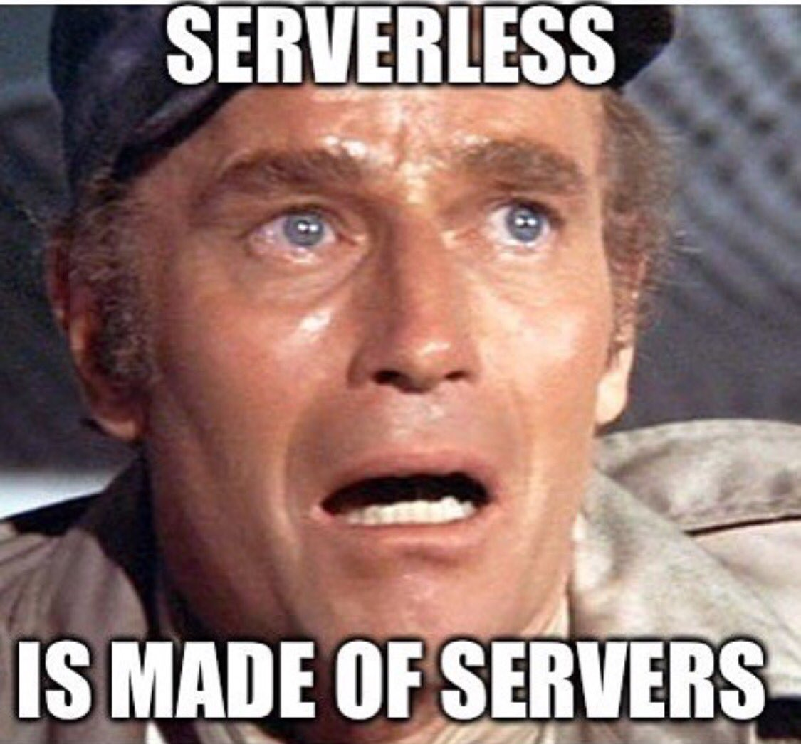

Slide 51

Multi-cloud
The use of multiple cloud computing and storage services in a single network architecture and the ability to be cloud-agnostic

Slide 52
Why Multi-cloud?
Build apps that work across multiple providers
Avoid vendor lock-in
Each provider has strenghts and weaknesses
A level of resiliency that is not available on a single provider

Slide 53
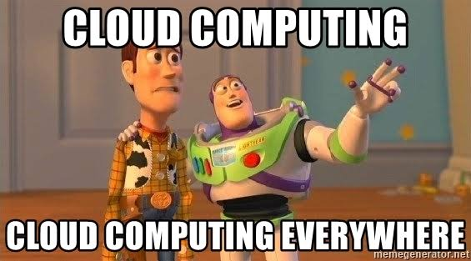

Slide 54
Configuration
public static IHostBuilder CreateHostBuilder(string[] args) =>
Host.CreateDefaultBuilder(args)
.ConfigureWebHostDefaults(webBuilder => {
webBuilder.ConfigureAppConfiguration(configBuilder => {
var keyVault = GetEnvironmentVariable("KEY_VAULT");
var clientId = GetEnvironmentVariable("CLIENT_ID");
var clientSecret = GetEnvironmentVariable("CLIENT_SECRET");
configBuilder.AddAzureKeyVault(keyVault, clientId, clientSecret);
});
webBuilder.ConfigureKestrel((ctx, options) => {
var key = GetEnvironmentVariable("CERTIFICATE_KEY");
var data = ctx.Configuration.GetValue<string>(key);
var certificate = new X509Certificate2(Convert.FromBase64String(data));
options.Listen(IPAddress.Any, 5000, listenOptions => {
listenOptions.UseHttps(certificate); });
}
});
webBuilder.UseStartup<Startup>();
});

Slide 55
Logging
public static IHostBuilder CreateHostBuilder(string[] args) =>
Host.CreateDefaultBuilder(args)
ConfigureLogging((hostContext, logging) => {
var elasticUri = hostContext.Configuration.GetValue<string>("elastic-uri");
if (!string.IsNullOrEmpty(elasticUri)) {
Log.Logger = new LoggerConfiguration()
.Enrich.FromLogContext()
.Enrich.WithExceptionDetails()
.WriteTo.Elasticsearch(new ElasticsearchSinkOptions(new Uri(elasticUri)) {
AutoRegisterTemplate = true
}).CreateLogger();
logging.AddSerilog();
}
});
});

Slide 56

DevOps
A set of practices that combines software development and IT-operations to shorten systems development lifecycle and provides continues delivery

Slide 57
What is DevOps
Working together
Automation (with tools)
Building
Testing
Deploying
Updating and upgrading
Scaling
Monitoring
Scripting (with tools)
Configuration as code
Source control!

Slide 58
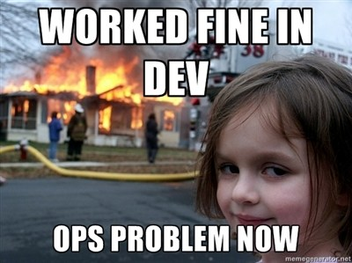

Slide 59
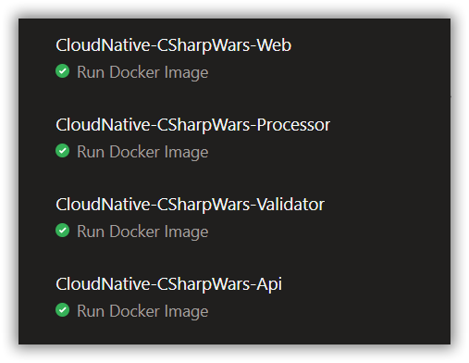
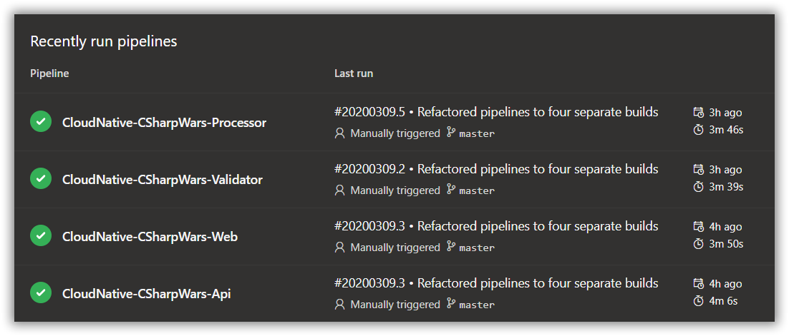
Azure DevOps Pipelines

Slide 60

Johnny Hooyberghs @djohnnieke
www.involved-it.be
github.com/Djohnnie/BuildCloudNativeApplications-TechoramaCafe-2020

